Slide 1
Student Attendance Tracking
Group B - Code Green
Sirisha Vanamali
Rohith Babu Sadhu
Vamsi Devalla
Sri Sai Ram Kumar Mamidala
Subba Reddy Pothireddy
Vipul Reddy Madadi
Shankar Rao Vallapurapu

Slide 2
Contents
Introduction
Modules and its core Functionalities
Demo
Requirements
Challenging Issues
Status
Implementation Strategy
Estimated Effort

Slide 3
Introduction
We want to develop a system which makes the life of an instructor easy in terms of tracking the attendance of a student with minimum effort.
Today, we are using different traditional ways which have certain limitations, ignoring them would make people easier to abuse them.
We will be using the QR codes for tracking the attendance of the students.

Slide 4
Modules and its core Functionalities
Student – To Scan QR
Instructor – To Generate QR
Admin – Manage both Students and Instructors

Slide 5

Requirements (Cntd…)
Instructor
Login and Logout
Generate the QR code
View Courses
Add/Remove Courses
View the Students who registered in instructor courses.
View/Modify attendance percentage for the students
Can edit user details if necessary.

Slide 6
Requirements
Student
Persistent Login
Scan the QR code
View attendance percentage according to the courses he/she registered
Once logged out, cannot login within 24 hours
Feedback

Slide 7
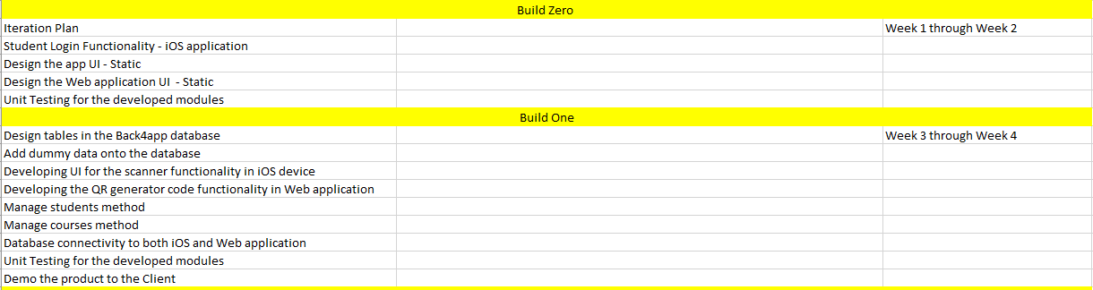
Iteration Plan

Slide 8
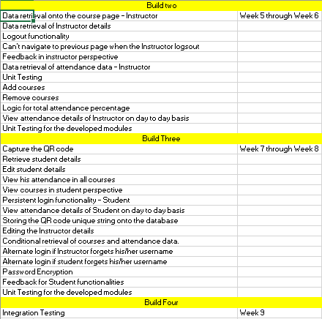
Iteration Plan

Slide 9


Slide 10
Challenging issues
Finalizing common database for iOS and web application.
Developing the Project in Node.js.
Deploying the swift code in iOS-11.
Writing code in Swift 4.

Slide 11
Status
We Completed all the functionalities in web application (Instructor point of view).
Started developing the iOS application completed login and signup functionalities.
Documented all the changes from GDP-I to GDP-II.

Slide 12
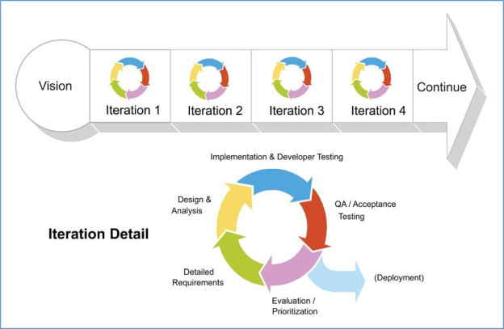
Implementation Strategy
Completing the Unit Tests after completion of every functionality which makes us easier to move forward.
Developing the project according to the Iteration plan.

Slide 13
Estimated efforts for completion of the project
As of now, we had a code of around 3000 lines (web application and iOS application).
We are expecting to have another 2000 lines of code.
We spent 6 weeks (15 hrs per week * 7 members) for this progress.
We are expecting to complete this project in coming 3 weeks and test all the cases in the remaining weeks before submission.
Equal distribution of tasks among team members.

Slide 14
Thank you Did we satisfy our Managers? Are you ready to fund us?

